Slide 1
Hamiltonian Circuits and Paths
Dr Honey Sharma
GGI, Ludhiana
Reference Book: Kenneth H. Rosen, Discrete Mathematics and its Applications, 7th ed, McGraw Hill

Slide 2
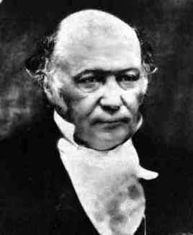
Sir William Rowan Hamilton
In the 19th century, an Irishman named Sir William R. Hamilton (1805-1865) invented a game called the Icosian game.
The game consisted of a graph in
which the vertices represented major
cities in Europe.

Slide 3
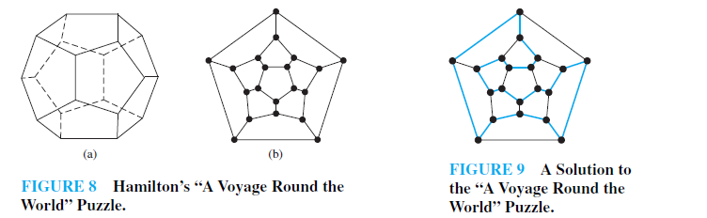
The Icosian Game
The objective of the game was to find a path that visited each of the 20 vertices exactly once and end back at the first city.
In honor of Hamilton and the his game, a path that uses each vertex of a graph exactly once is known as a Hamiltonian path.

Slide 4
HAMILTON PATHS & CIRCUITS
■ A Hamilton path in a graph is a path that includes each vertex of the graph once and only once.
■ A Hamilton circuit is a circuit that includes each vertex of the graph once and only once. (At the end, of course, the circuit must return to the starting vertex.)

Slide 5
Euler vs. Hamilton Paths & Circuits
On the surface, there is a one-word difference between Euler paths/circuits and Hamilton paths/circuits:
The former covers all edges; the latter covers all vertices.

Slide 6
We require “Hamilton circuit and path theorems” that we could use to determine if a graph has a Hamilton circuit, a Hamilton path, or neither.
Surprisingly, no such theorems exist.
Determining when a given graph does or does not have a Hamilton circuit or path can be very easy, but it also can be very hard–it all depends on the graph.

Slide 7
DIRAC’S Theorem: if G is a simple graph with n vertices with n ≥ 3 such that the degree of every vertex in G is at least n/2 then G has a Hamilton circuit.
ORE’S Theorem: if G is a simple graph with n vertices with n ≥ 3 such that deg (u) + deg (v) ≥ n for every pair of nonadjacent vertices u and v in G, then G has a Hamilton circuit.
Both Ore’s theorem and Dirac’s theorem provide sufficient conditions for a connected simple graph to have a Hamilton circuit. However, these theorems do not provide necessary conditions for the existence of a Hamilton circuit. For example, the graph C5 has a Hamilton circuit but does not satisfy the hypotheses of either Ore’s theorem or Dirac’s theorem, as the reader can verify.

Slide 8
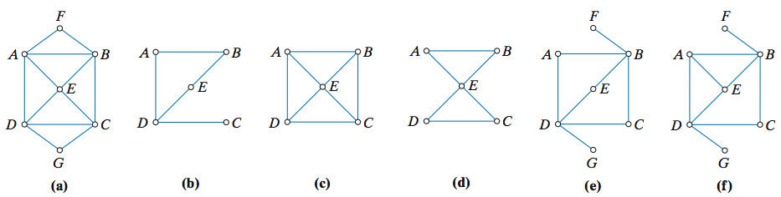
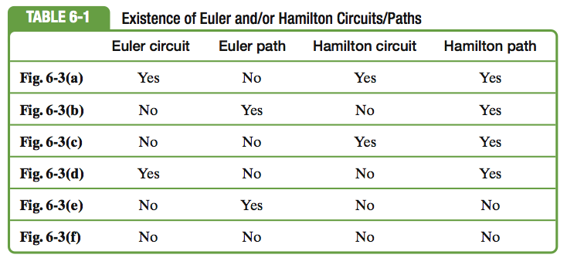
Examples

Slide 9
Show that Kn has a Hamilton circuit whenever n ≥ 3.
Solution : We can form a Hamilton circuit in Kn beginning at any vertex. Such a circuit can be built by visiting vertices in any order we choose, as long as the path begins and ends at the same vertex and visits each other vertex exactly once. This is possible because there are edges in Kn between any two vertices.

Slide 10
Work from Home
Give an example of following graphs
Having Euler and Hamilton circuit both
Neither Euler Circuit nor Hamilton circuit
Having Euler circuit but no Hamilton circuit and vice versa
Having Euler and Hamilton path both
Neither Euler path nor Hamilton path
Having Euler path but no Hamilton path and vice versa

